Slide 1
Cardio Vascular Disease (CVD)
TEAM 15
Deepakvanshikumar Tuniya
Komal PimPARIYA

Slide 2
Business Context & Problem Statement
Healthcare company going through CVD reports of patient to check who is at risk of diseases and if they can apply control measures to prevent those who are at borderline as the disease is number 1 cause of death globally.
Healthcare consultant looking into Cardiovascular Disease(CVD) Patient examination results to predict if they have CVD or not by model comparison technique.
Focusing on the patients that don’t have CVD and to check on risk factors and aspects like alcohol consumption and smoking if done in excess can affect them with CVD.

Slide 3
Tackling Business Idea.
Patient profile would be different based on health and lifestyle patterns.
To achieve the goal patients will be segregated on their habits such as smoker or non-smoker and consumption of alcohol.
Paying more attention to people who don’t have CVD but can have the diseases if frequency of their habits increase.
The company has factual information, information given by the patient and results of medical examination to support business problem.
Resources:
Excel
Python
SAS

Slide 4
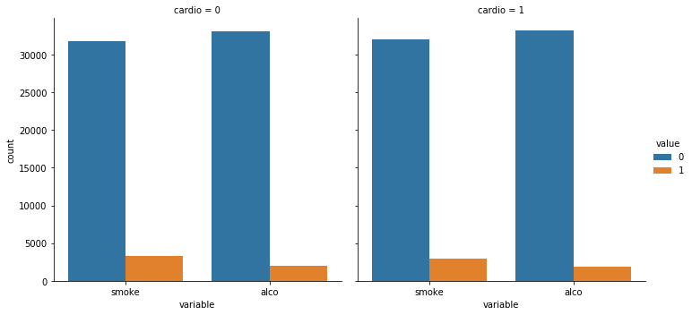
Data Description and Data Visualization
Data consist of 70,000 rows, 13 observations, 4 binary variables, 1 categorical variable, 5 continuous variables and target variable ‘cardio’.
Bar plot of variable smoke and alcohol which is segregated on the basis of patients with cardiovascular diseases and patient without it.
Target variable is well balanced with 50.7% patients having CVD and 49.3% not having CVD.

Slide 5
Data Mining Models:
Target variable ‘Cardio’ is used for prediction of data.
Outcome variable is a binary variable with patients having CVD as ‘1’ and those who don’t as ‘0’.
As data is binary, classification data mining models are used for prediction of business problem.
Four top performing data mining models have been applied.
Logistic Regression
Decision Tree
eXtreme Gradient Boosting
Random Forest

Slide 6
Model Description
Logistic Regression: The regression model is used to examine relationship between binary target variable ‘cardio’ and independent variables which will have only two outcomes.
Decision Trees: Decision Tree is applied to implement training model which predicts target variable ‘cardio’ by learning simple decision rules inferred from prior training data.
eXtreme Gradient Boosting: This models suits well as it uses many trees where one tries to predict the target variable ‘cardio’ and another tries to predict the residual of first tree and so on.
Random Forest: As this is a classification problem, decision trees are generated from the training data for those who don’t have CVD. Votes are collected from each tree and best are selected by votes. Most voted tree is final prediction.

Slide 7
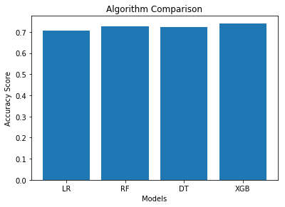
Result Discussion
Results of the for data mining models are based on seven measures such as model accuracy, confusion matrix, precision, recall, f1-score,support and auc scores.
Model accuracy is overall model performance and efficiency with consideration of other six measures.
In the bar plot, the model comparison displays accuracy scores of four models applied. It is seen there’s negligible difference in the performance.
Logistic Regression having 70.9% accuracy, Decision Tree 72.4% , Random forest 72.8% and xGBoost is the top performing model with 73.9% accuracy.
Comparing all measures, xGBoost is the best prediction model to predict if a patient has presence or absence of Cardiovascular Diseases(CVD).

Slide 8
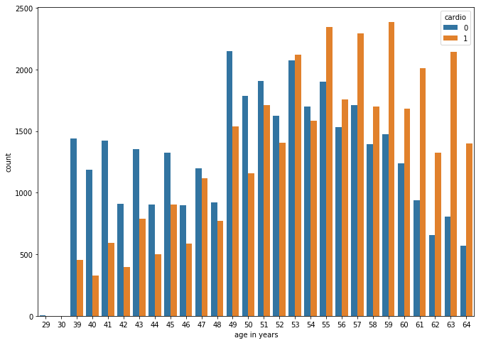
Interpretation of Result
The count plot displays examination results of patients segregated by age.
Graph displays that patients with age 50 have more presence of CVD.
This states that patients with age 50 not having CVD should be more focused by the company to look for risk of getting diseases, their habits and lifestyle patterns need to be taken care of.

Slide 9
Managerial Insights
Extra attention provided to patients with age 50 and above.
Promote good lifestyle and spread awareness about smoking can be harmful causing CVD.
Imply a limit in consumption of alcohol.
Keep a regular tab on health attributes like blood pressure, cholesterol level and sugar levels.
Inculcate physical fitness for the patients according to their BMI as we have gender, height and weight stats of patient.

